Slide 1
Employee Data Analysis using Excel
STUDENT NAME : MANISHA.S
REGISTER NO :312203070
DEPARTMENT : B.COM( CA ) 3RD YEAR
COLLEGE : ASAN MEMORIAL ARTS AND SCIENCE COLLEGE

Slide 2
PROJECT TITLE
Employee Performance Analysis using Excel

Slide 3


AGENDA
Problem Statement
Project Overview
End Users
Our Solution and Proposition
Dataset Description
Modelling Approach
Results and Discussion
Conclusion
3/21/2024 Annual Review

Slide 4
PROBLEM STATEMENT FOR EMPLOYEE PERFORMANCE ANALYSIS
Enables employee growth and development
Create goal alignment and company growth
Better understand your company performance
Know who to build your culture around
Create a fair culture of recognition

Slide 5

PROJECT OVERVIEW
A performance review is a regulated assessment in which managers evaluate an employee’s work performance to identify their strengths and weaknesses, offer feedback and assist with goal setting.
An employee performance evaluation, also known as a “performance review,” is a process used by organizations to give employees feedback on their job performance and formally document that performance. Although companies determine their own evaluation cycles, most conduct employee performance evaluations once per year.

Slide 6
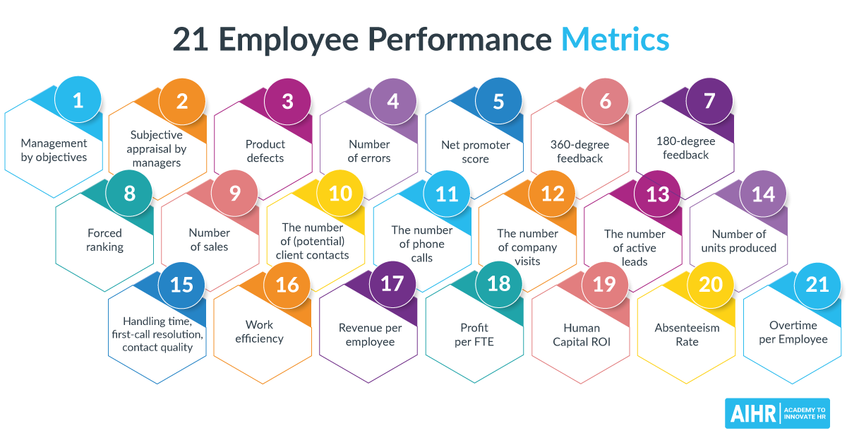

WHO ARE THE END USERS?

Slide 7

OUR SOLUTION AND ITS VALUE PROPOSITION
PERFORMANCE LEVEL
HIGH
LOW
VERY HIGH
MED
MED
MED
LOW
MED
MED

Slide 8
Dataset Description
PERFORMANCE LEVEL
HIGH
LOW
VERY HIGH
MED
MED
MED
LOW
MED
MED

Slide 9

THE "WOW" IN OUR SOLUTION
GenderCode | (Multiple Items)
Count of FirstName | Column Labels
Row Labels | HIGH | LOW | MED | VERY HIGH | Grand Total
BPC | 16 | 34 | 85 | 15 | 150
CCDR | 18 | 47 | 65 | 15 | 145
EW | 21 | 41 | 78 | 14 | 154
MSC | 17 | 39 | 92 | 9 | 157
NEL | 21 | 41 | 77 | 15 | 154
PL | 29 | 33 | 69 | 12 | 143
PYZ | 26 | 41 | 75 | 15 | 157
SVG | 26 | 43 | 82 | 16 | 167
TNS | 21 | 45 | 71 | 13 | 150
WBL | 25 | 34 | 84 | 13 | 156
Grand Total | 220 | 398 | 778 | 137 | 1533
3/21/2024 Annual Review
9

Slide 10
MODELLING
GenderCode | (Multiple Items)
Count of FirstName | Column Labels
Row Labels | HIGH | LOW | MED | VERY HIGH | Grand Total
BPC | 8 | 19 | 56 | 12 | 95
CCDR | 12 | 39 | 44 | 8 | 103
EW | 13 | 28 | 53 | 12 | 106
MSC | 12 | 27 | 72 | 5 | 116
NEL | 15 | 34 | 57 | 12 | 118
PL | 17 | 19 | 43 | 10 | 89
PYZ | 18 | 25 | 49 | 11 | 103
SVG | 17 | 28 | 53 | 12 | 110
TNS | 10 | 32 | 45 | 10 | 97
WBL | 18 | 24 | 61 | 8 | 111
Grand Total | 140 | 275 | 533 | 100 | 1048
10

Slide 11
RESULTS
11

Slide 12
Conclusion: The evaluation of workers' performance is directed toward two fundamental goals. The first of these is to create a measure that accurately assesses the level of an individual's performance on something called the job. The second is to create a performance measurement system that will advance one or more operational functions in an organization: personnel decisions, compensation policy, communication of organizational objectives, and facilitation of employee.

